Slide 1
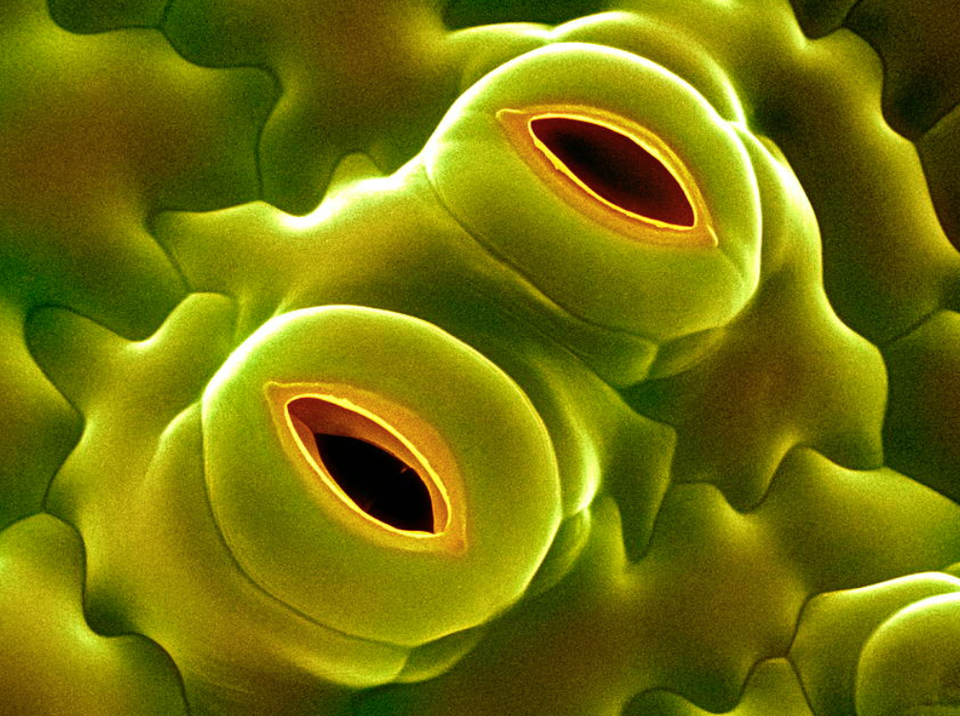
Lesson 7: The economics of leaves
Spring riddle:
What’s this ?
Source:
www.emaze.com
With A. Koch, 12. April, 2016

Slide 2
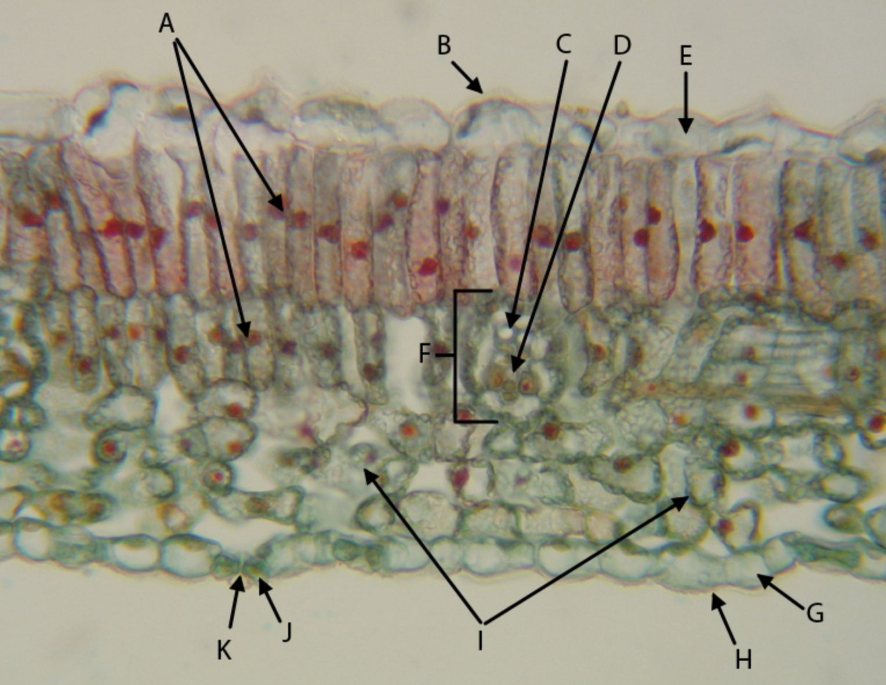
Cross section of a lilac leaf (Syringa vulgaris, Oleaceae; a monocot)
http://www.imagejuicy.com/images/plants/s/syringa/2/

Slide 3
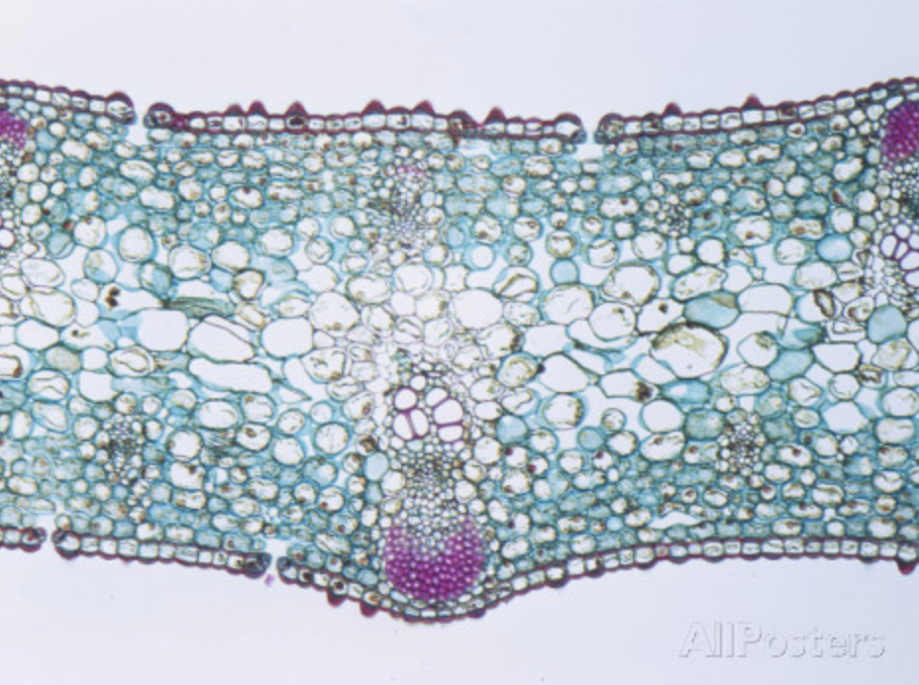
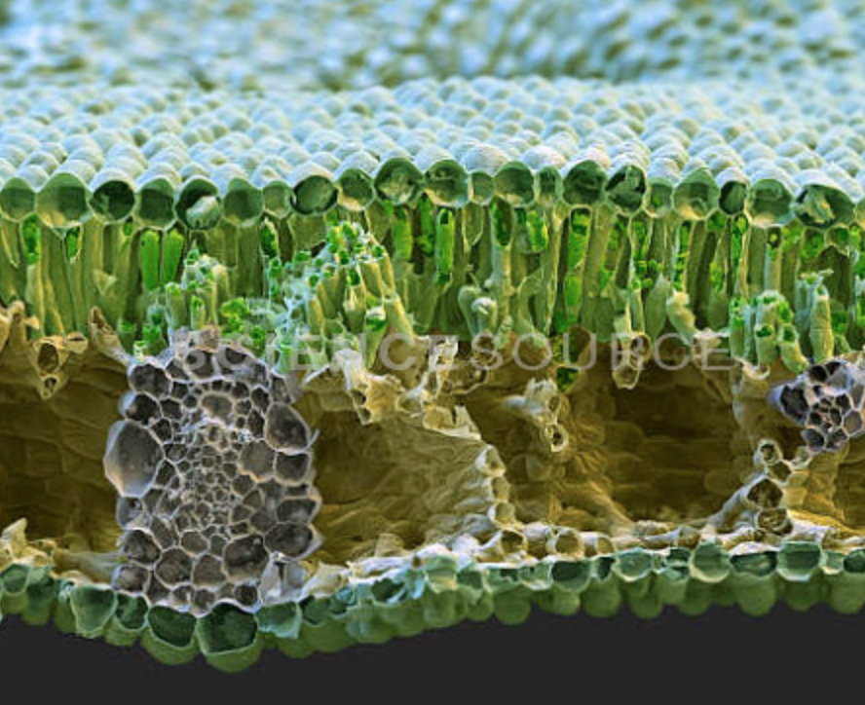
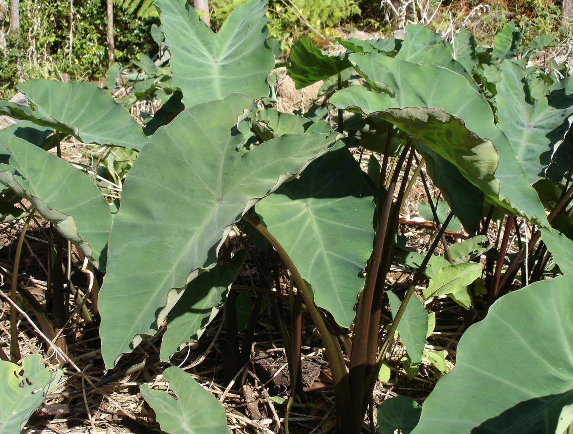
Cross section of an iris leaf
(Iris ssp., Iridaceae; a monocot)
Cross section of a Taro leaf
(Colocasia esculenta, Araceae; a monocot)
http://www.allposters.com/-sp/Cross-Section-of-an-Iris-Monocot-Leaf-LM-X22-Posters_i9013792_.htm
http://images.sciencesource.com/preview/bs9612.html
https://en.wikipedia.org/wiki/Colocasia_esculenta#/media/File:Songe-Réunion.JPG

Slide 4
Assignment:
Within the groups 1, 2, and 3: Discuss for a few minutes in the results of the
light experiment (group 1)
Transpiration experiment (tap water, group 2)
Transpiration experiment (salt water, group 3)
What does it mean? What research question is being addressed ?
What can we conclude ?

Slide 5
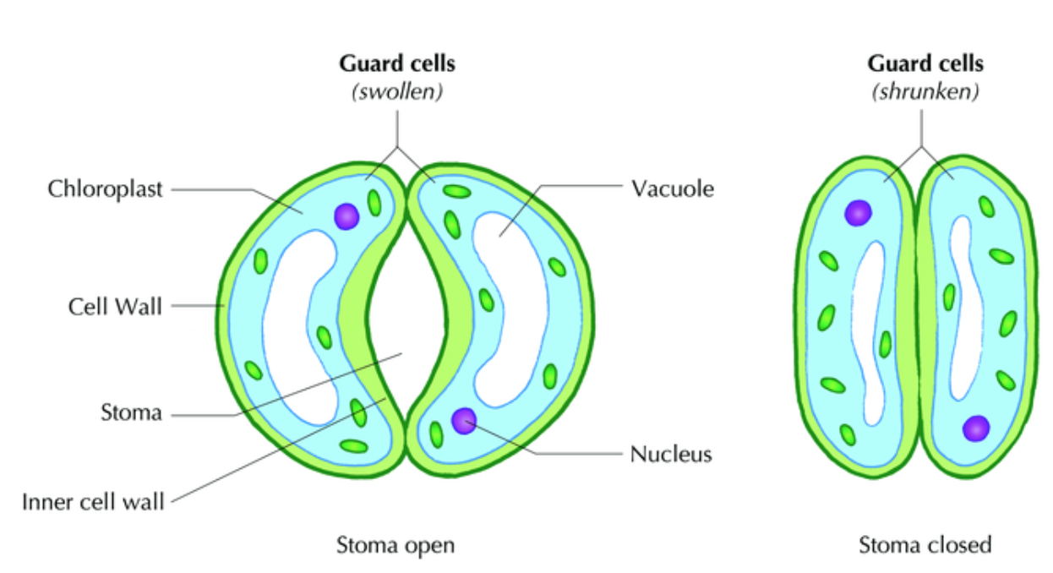
turgid
flaccid

